Slide 1
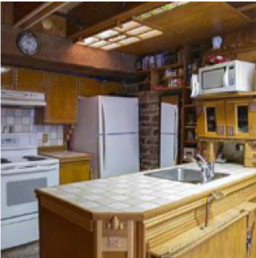
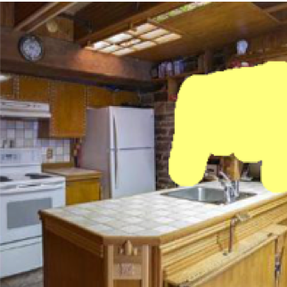
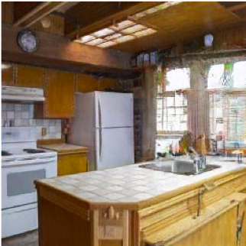
Image Editing with Optimization (part II)
Jun-Yan Zhu 16-726, Spring 2021
© GANPaint [Bau et al. 2019]

Slide 2
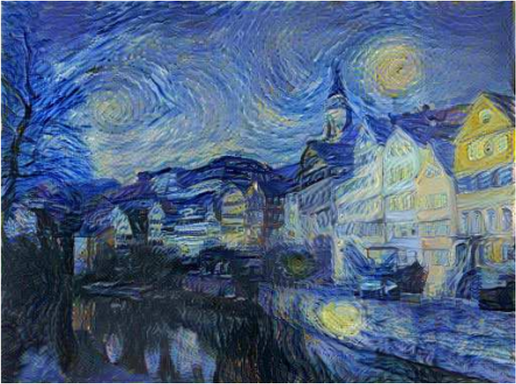
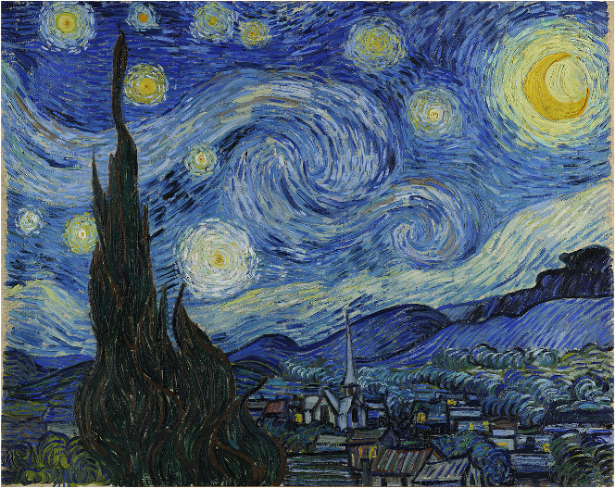
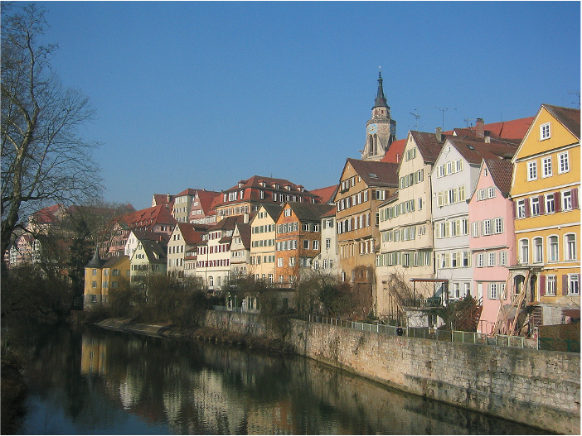


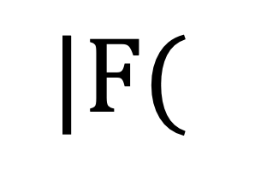
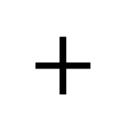
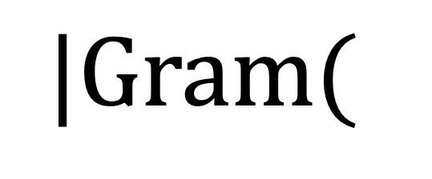
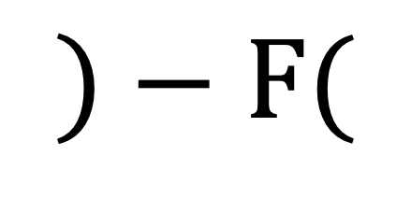
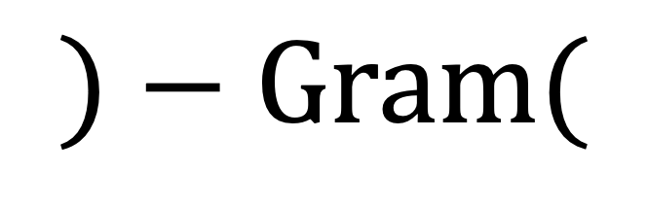
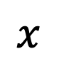
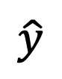
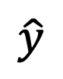
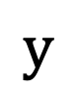
Image Editing with Optimization
$$\hat{y}$$
$$y$$
$$|Gram($$
$$)−Gram($$
$$)|$$
optimized output
style image
$$\hat{y}$$
$$x$$
$$+$$
$$|F($$
$$)−F($$
$$)|$$
optimized output
content image
User input
Input image
2

Slide 3
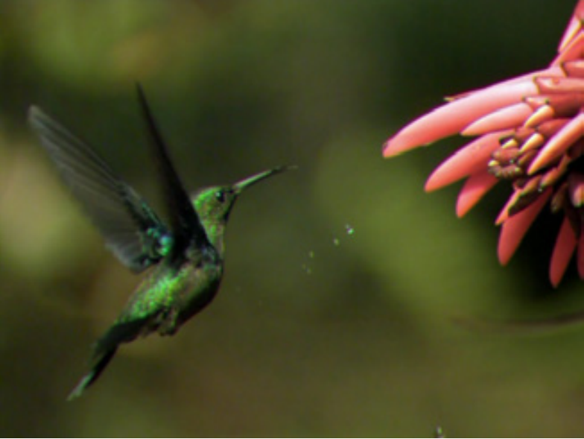
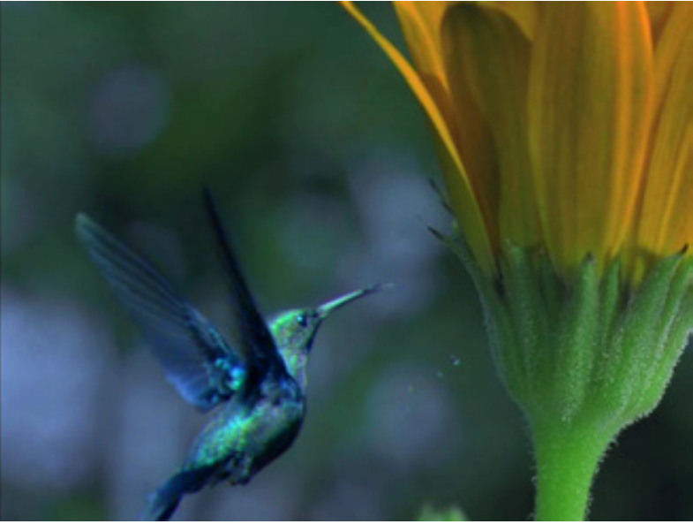
Image Editing with Optimization
Image Editing Program
input photo
result
User Input
result
background
result
object
[Pérez et al. 2003], [Tao et al. 2014]

Slide 4
Learning Natural Image Manifold
Deep generative models:
Generative Adversarial Network (GAN)
(e.g., DCGAN, StyleGAN2, BigGAN)
Variational Auto-Encoder (VAE)
(e.g., VQ-VAE2)
Flow-based models (e.g., RealNVP, Glow)…
…

Slide 5
Changing Variables
Traditional method: Optimizing the image
New method: Optimizing the latent code
user constraint
input
result
user constraint
input
Latent code
Generator

Slide 6
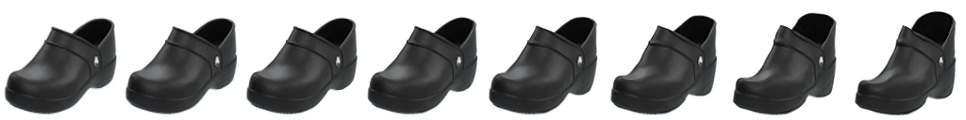
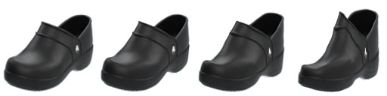

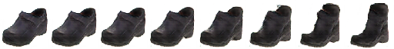

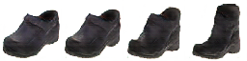
Projecting and Editing an Image
original photo
different degree of image manipulation
Project
Edit Transfer
Editing UI
projection on manifold
transition between the original and edited projection

Slide 7
Projecting and Editing an Image
original photo
different degree of image manipulation
Project
Edit Transfer
Editing UI
projection on manifold
transition between the original and edited projection

Slide 8
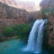

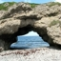
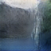
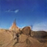
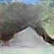
Projecting an Image into GAN Manifold
Input: real image
Output: latent vector
Optimization
0.196
0.238
0.332
Reconstruction loss
Generative model

Slide 9
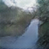
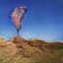
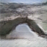
Projecting an Image into GAN Manifold
Input: real image
Output: latent vector
Optimization
0.196
0.238
0.332
Inverting Network
Auto-encoder
with a fixed decoder
0.218
0.242
0.336
also see VAE-GAN based image projection
Neural Photo Editor [Brock et al. ICLR 2017]

Slide 10
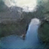
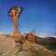
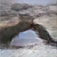
Projecting an Image into GAN Manifold
Input: real image
Output: latent vector
Optimization
0.196
0.238
0.332
Inverting Network
0.218
0.242
0.336
Hybrid Method
Use the network as initialization
for the optimization problem
0.153
0.167
0.268

Slide 11
Manipulating the Latent Code
original photo
different degree of image manipulation
Project
Edit Transfer
Editing UI
projection on manifold
transition between the original and edited projection

Slide 12
Post-Processing (optional)
original photo
different degree of image manipulation
Project
Edit Transfer
Editing UI
projection on manifold
transition between the original and edited projection

Slide 13
Image Editing with GANs
Step 1: Image Projection/Reconstruction
Step 2: Manipulating the latent code
Step 3: Generate the edited result

Slide 14
Image Projection with GANs

Slide 15
Image Reconstruction (high-res images, Big Models)
Original image

Slide 16


Image Reconstruction (high-res images, Big Models)
Random vector
?
Original image
iGAN [Zhu et al. 2016]

Slide 17
Image Reconstruction (high-res images, Big Models)
Random vector
Reconstructed image
iGAN [Zhu, Krähenbühl, Shechtman, Efros]

Slide 18
Find the Differences…
Original image
GAN reconstructed image

Slide 19
Find the Differences…
No lamp
No microwave
No window
No stove
No chairs/table
No something there
No plug
Original image
GAN reconstructed image

Slide 20
Reconstructing a Real Photo
Original image
Random vector
Reconstructed image
iGAN [Zhu et al. 2016]

Slide 21
Reconstructing a Real Photo
Original image
Random vector
Weight space regularizer
Feature space regularizer
Reconstructed image
Regularizer
Notes:
We also modify the generator network theta. Of course, if you modify the network too much, it will start overfitting, and lose the original structure. [C} Therefore, we add a regularizer that enforces the new model stays close to the original model.

Slide 22

Reconstructing a Real Photo
Original image
Random vector
Reconstructed image
Regularizer

Slide 23
Reconstructing a Real Photo
Original image
With
With and
Semantic Photo Manipulation [Bau, Strobelt, Peebles, Wulff, Zhou, Zhu, Torralba, SIGGRAPH 2019]
Inspired by Deep Image Prior [Ulyanov et al.] and Deep Internal learning [Shocher et al.]

Slide 24
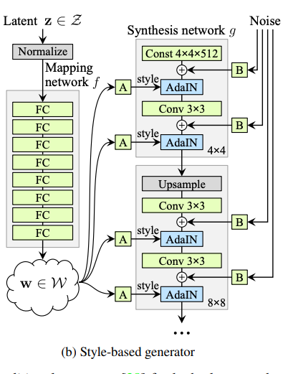
Using Different Layers
Optimizing the latent code
Optimizing the style code
Optimizing the extended style code
Image2StyleGAN [Abdal et al., 2019], StyleGAN2 [Karras et al., 2019]

Slide 25
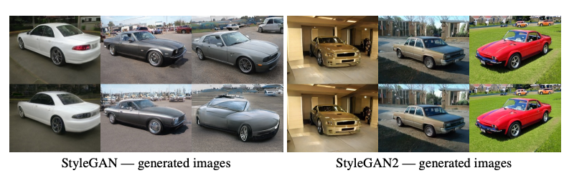
Using Different Layers: w space
StyleGAN2 [Karras et al., 2019]

Slide 26
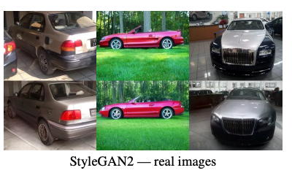
Using Different Layers: w space
StyleGAN2 [Karras et al., 2019]

Slide 27
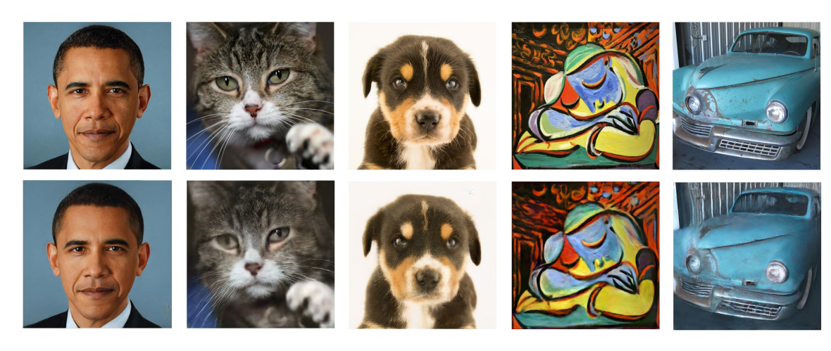
Using Different Layers: w+ space
All the results are reconstructed using Face Model
Image2StyleGAN [Abdal et al., 2019]

Slide 28
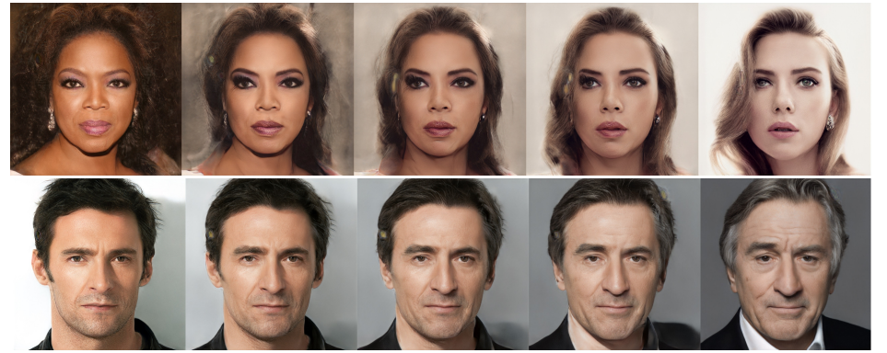

Reconstruction $≠$ Editing
Interpolations between two images
Image2StyleGAN [Abdal et al., 2019]

Slide 29
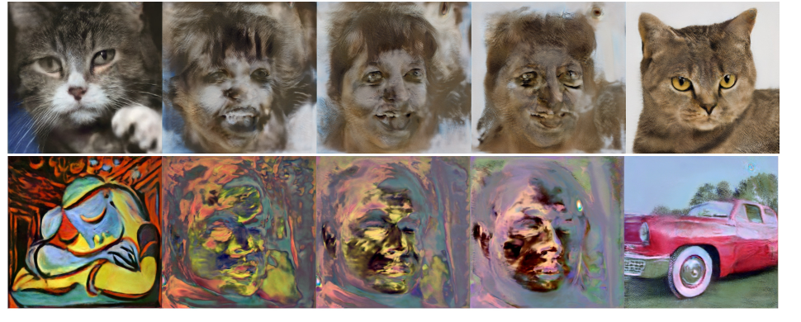
Reconstruction $≠$ Editing
Interpolations between two images
Image2StyleGAN [Abdal et al., 2019]

Slide 30
Manipulating Latent code/layer (channel analysis)

Slide 31
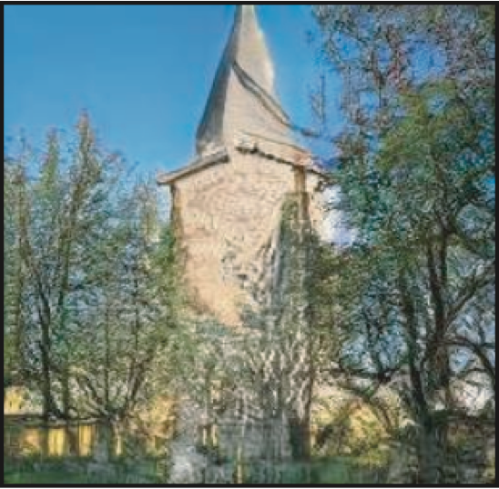
Understanding a Generator
Each step:
Increases spatial resolution
Output image
Each layer consists of a set of neurons
width
Input: random vector z
height
Examine each neuron
What happens inside?
Progressive GANs [Karras et al. 2018]

Slide 32

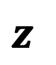
Which neurons correlate to an object class?
generated image
generate
$$z$$
generator
[Bau, Zhu, Strobelt, Zhou, Tenenbaum, Freeman, Torralba. ICLR 2019]
Notes:
So we can first generate an image,

Slide 33
Which neurons correlate to an object class?
featuremap
single neuron
generated image
generate
$$z$$
generator
[Bau, Zhu, Strobelt, Zhou, Tenenbaum, Freeman, Torralba. ICLR 2019]

Slide 34

Which neurons correlate to an object class?
featuremap
high response
single neuron
generated image
generate
$$z$$
generator
[Bau, Zhu, Strobelt, Zhou, Tenenbaum, Freeman, Torralba. ICLR 2019]

Slide 35



Which neurons correlate to an object class?
featuremap
high response
single neuron
agreement
generated image
sky
building
generate
$$z$$
labeling
tree
generator

Slide 36
Which neurons correlate to an object class?
Church samples
Tree
Neuron
Dome
Neuron

Slide 37
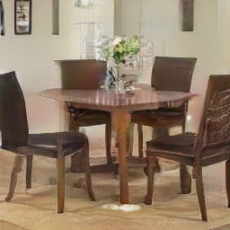
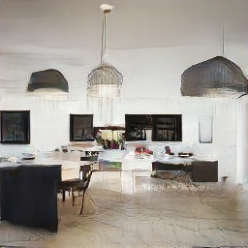
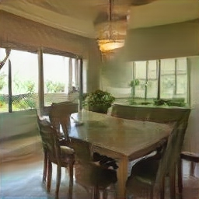
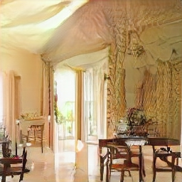
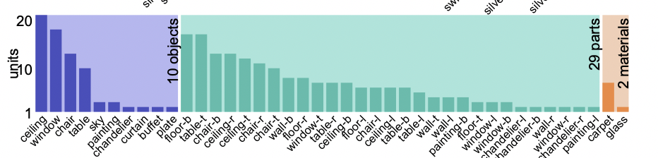
Which neurons correlate to an object class?
Dining room samples
252 out of 512 neurons are correlated to objects, part, and materials
Window
Neuron
Table
Neuron

Slide 38
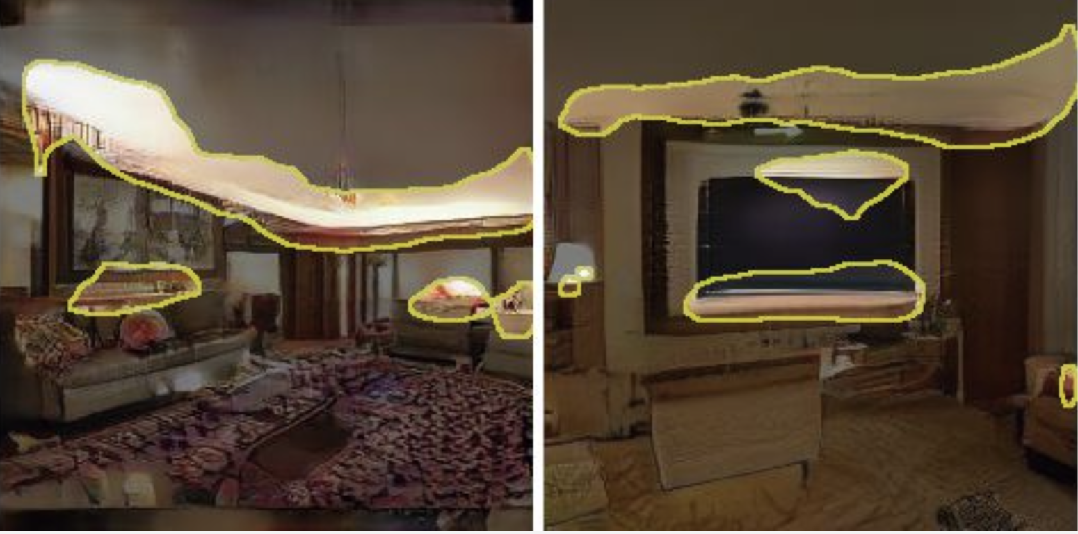
Which neurons correlate to an object class?
Living room model
code
Image
Layout
Object and parts
Edges, textures, local structure

Slide 39
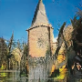
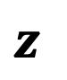
Which neurons cause an object class?
featuremap
single neuron
generated image
generate
$$z$$
generator
[Bau, Zhu, Strobelt, Zhou, Tenenbaum, Freeman, Torralba. ICLR 2019]

Slide 40
Which neurons cause an object class?
featuremap
turn off the neuron
single neuron
generated image
Image with neuron off
generate
$$z$$
generator
[Bau, Zhu, Strobelt, Zhou, Tenenbaum, Freeman, Torralba. ICLR 2019]

Slide 41
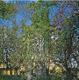
Which neurons cause an object class?
featuremap
turn off the neuron
single neuron
generated image
Image with neuron off
generate
$$z$$
generator
[Bau, Zhu, Strobelt, Zhou, Tenenbaum, Freeman, Torralba. ICLR 2019]

Slide 42
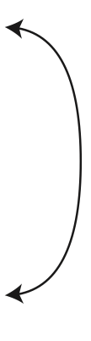
Which neurons cause an object class?
featuremap
turn off the neuron
turn on the neuron
single neuron
generated image
Image with neuron off
Image with neuron on
generate
$$z$$
generator
average causal effect

Slide 43
















Which neurons cause an object class?

Slide 44


Object-Scene Relationships
Turn off person neurons

Slide 45


Object-Scene Relationships
Turn off window neurons

Slide 46


Object-Scene Relationships
Turn off table neurons

Slide 47


Object-Scene Relationships
Turn off chair neurons

Slide 48
Object-Scene Relationships

Slide 49


Object-Scene Relationships
Yellow box: highlight every location where we can insert doors

Slide 50


Object-Scene Relationships
Yellow box: highlight every location where we can insert doors

Slide 51
Object-Scene Relationships
Notes:
Here is the quantitative evaluation, which says [sez] that you can turn a window into a door, or add a door on buildings, but models refuse to add doors to trees and sky. Why is that? ||| because this will break realism, and make things look unrealistic, and the model has captured that.

Slide 52


Debugging and Improving Models
Neuron #63
Neuron #231
Turning off neurons removes artifacts
Images with artifacts
Example artifact-causing neurons

Slide 53


Interactive Painting
Online Demo
http://bit.ly/ganpaint

Slide 54

Interactive Painting
Online Demo
http://bit.ly/ganpaint

Slide 55





Manipulating a Real Photo
Original image + edits
Editing with $\hat{z}$
Editing with $\hat{z} and\hat{ θ}$
Semantic Photo Manipulation [Bau, Strobelt, Peebles, Wulff, Zhou, Zhu, Torralba, SIGGRAPH 2019]
]

Slide 56



Manipulating a Real Photo
Input image
Remove chairs
Output result
Semantic Photo Manipulation [Bau, Strobelt, Peebles, Wulff, Zhou, Zhu, Torralba, SIGGRAPH 2019]

Slide 57
Manipulating a Real Photo
Input image
Add windows
Output result
Semantic Photo Manipulation [Bau, Strobelt, Peebles, Wulff, Zhou, Zhu, Torralba, SIGGRAPH 2019]

Slide 58



Manipulating a Real Photo via GAN Dissection
Input image
Restyle trees for spring
Restyle trees for autumn
Semantic Photo Manipulation [Bau, Strobelt, Peebles, Wulff, Zhou, Zhu, Torralba, SIGGRAPH 2019]

Slide 59


Slide 60
Manipulating Latent code/layer (computing directions offline)

Slide 61


Compute $Δz$
First annotate images, then compute directions
DCGAN [Radford et al. 2016]

Slide 62
Manipulating Latent code/layer (PCA directions)

Slide 63

GANSpace: Discovering PCA directions
First compute potential directions (PCA), then annotate directions
GANspace [Härkönen et al. 2020]

Slide 64

GANSpace: Discovering PCA directions
Also see “Editing in Style: Uncovering the Local Semantics of GANs”, Collins et al., CVPR 2020
“Closed-Form Factorization of Latent Semantics in GANs”, Shen and Zhou. CVPR 2021
GANspace [Härkönen et al., 2020]

Slide 65

GANSpace: Discovering PCA directions
GANspace [Härkönen et al., 2020]

Slide 66
Manipulating Latent code/layer (offline optimization)

Slide 67

Offline optimization
Given a pre-defined function edit and a pre-trained generator G
Linear case:
(w is a vector)
Non-linear case:
(f is a function)
apply it n times
[Jahanian*, Chai*, Isola. 2020]

Slide 68

Offline optimization
Requirement: A known edit function
[Jahanian*, Chai*, Isola. 2020]
Notes:
a

Slide 69
Different Ways of Using Networks
Train a network to produce images (instead of hand-crafted filters)
Image-to-Image Translation, Fast Neural Style Transfer, Image Super-resolution
Define a Loss function based on a network (instead of pixel loss)
Perceptual Loss, Adversarial Loss, Contrastive Learning loss
Using networks’ features (instead of pixels, edges, or wavelets)
Gram matrix, Deep Image Analogy
Optimizing the latent code of a generative model (instead of raw pixels)
GAN Projection (iGAN, Image2StyleGAN), Latent vector editing
Optimizing the weights of a network
Deep Image Prior, GANPaint

Slide 70

Thank You!
16-726, Spring 2021
https://learning-image-synthesis.github.io/
video © [Shen and Zhou, CVPR 2021]

